Slide 1

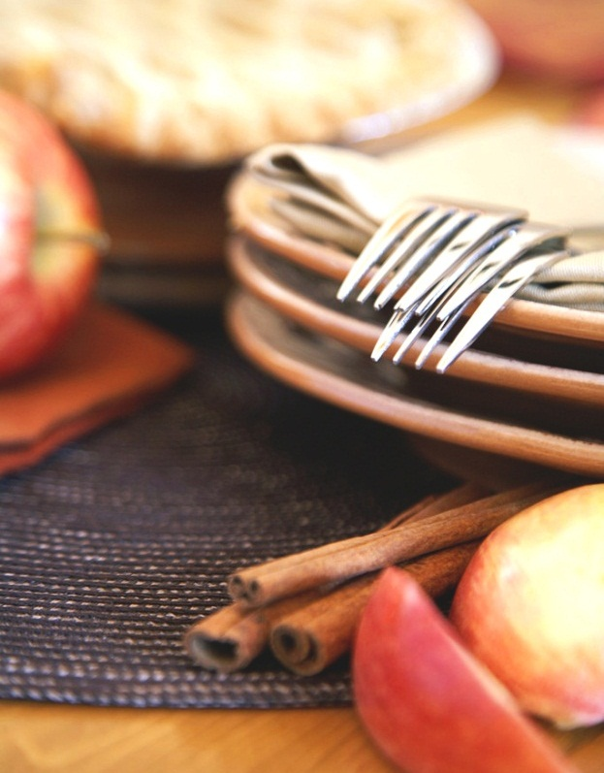
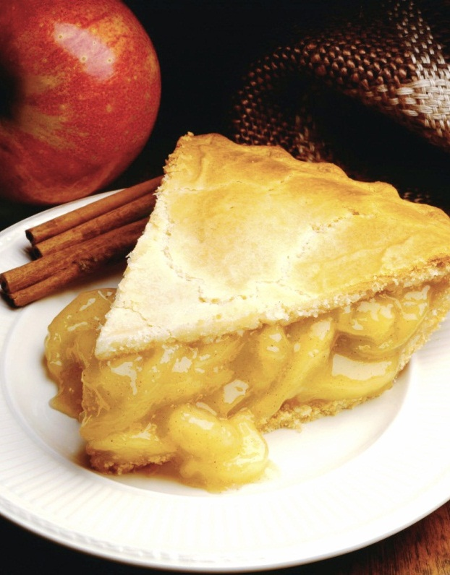
Meemaw’s Desserts
Group 1: Eric, Stacey, Sebastian, Ashley, Aschby, Dom
Notes:
NOTE: To replace a picture, just select and delete it. Then use the Insert Picture icon to replace it with one of your own!

Slide 2
Brief Summary of Meemaw’s Desserts
Definition: The purpose of this database is to create an encyclopedia of recipes beneficial to those with introductory or little to no knowledge of cooking. It enhances the development of cooking practices to college students, especially those who are time-consumed. The goal of this recipe book is to provide them with an efficient start.
Why? Students’ schedules are packed, and they can be indecisive and flooded with various recipes when googling desserts to make. This database can improve their life skills because it optimizes well-deserved time into cooking and maximizes their time for academics.
Present System: Recipes are essential keys in replicating and noting food dishes. They’re coordinated with steps, cooking methods, ingredients, and alternative substitutions for those with dietary restrictions and/or allergies. Due to the vast number of dishes created and continually being made, implementation of recipes has become an accessible resource to anyone anywhere in the world

Slide 3
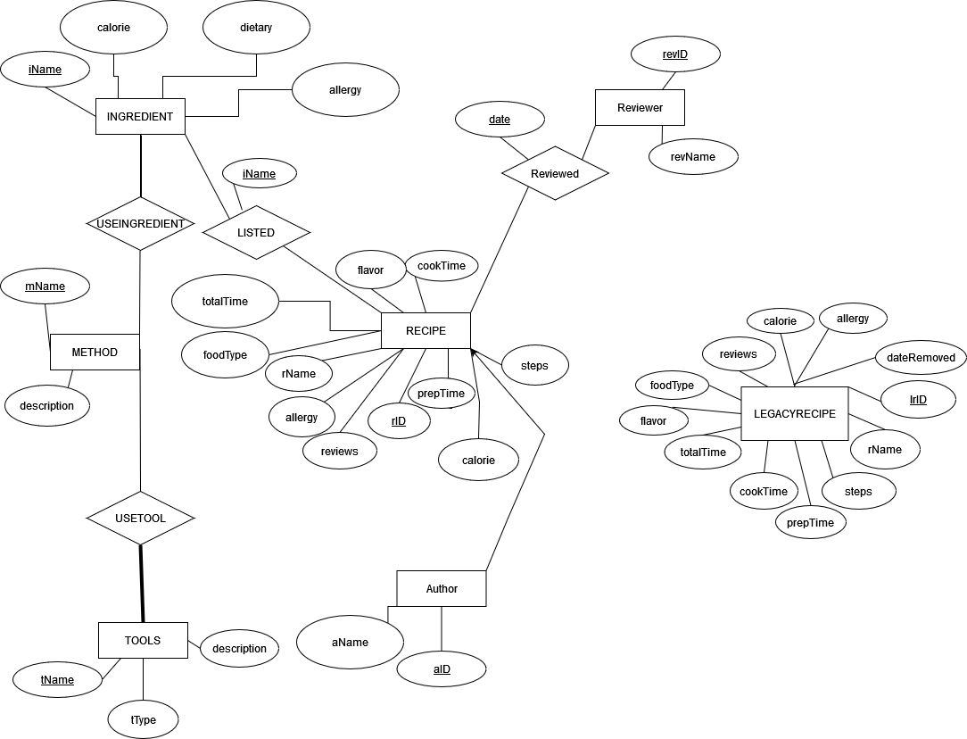

Slide 4
Building the Database in SQL

Slide 5
CREATE TABLE RECIPE (
rID INT(7),
rName VARCHAR(30),
steps VARCHAR(2000) NOT NULL,
prepTime INT(5) NOT NULL,
cookTime INT(5) NOT NULL,
totalTime INT(5),
flavor VARCHAR(6) NOT NULL CHECK (flavor IN(“Sweet”, "Salty", "Savory", "Umami", "Sour", "Bitter", "Spicy")),
foodType VARCHAR(10) NOT NULL CHECK (foodType IN("cookie", "cake", "ice cream", "pie", "bread", "muffin", "cobbler", "misc")),
reviews INTEGER(5),
calorie INTEGER(5),
allergy VARCHAR(100),
PRIMARY KEY (rID));
Constraints: The RECIPE table contains constraints to make sure the flavor matches a known in the system and if foodType matches a known in the system.

Slide 6
INSERT INTO RECIPE (rID, rName, steps, prepTime, flavor, foodType)
VALUES
(001, "Banana Bread", "1. Preheat the oven to 350 degrees F (175 degrees C). Lightly grease a 9x5-inch loaf pan. / 2. Combine flour, baking soda, and salt in a large bowl. Beat brown sugar and butter with an electric mixer in a separate large bowl until smooth. Stir in eggs and mashed bananas until well blended. Stir banana mixture into flour mixture until just combined. Pour batter into the prepared loaf pan. / 3. Bake in the preheated oven until a toothpick inserted into the center comes out clean, about 60 minutes. Let bread cool in pan for 10 minutes, then turn out onto a wire rack to cool completely.", 15, 60, NULL, "Sweet", "Bread", NULL, NULL, NULL),
(002, "Vanilla Cupcakes", "1. Preheat the oven to 350 degrees F. Line a 12-cup muffin pan with paper liners. Whisk the flour, baking powder and salt in a bowl. Beat the butter and sugar in a stand mixer fitted with the paddle attachment on medium-high speed until fluffy, about 4 minutes. Beat in the eggs, one at a time, scraping down the bowl as needed. Beat in the vanilla. Reduce the mixer speed to medium low; beat in half of the flour mixture, then all of the milk, then the remaining flour mixture until just combined. / 2. Divide the batter among the muffin cups, filling each three-quarters full. Bake until a toothpick inserted into the center of a cupcake comes out clean, 18 to 20 minutes, rotating the pan halfway through. Transfer the pan to a rack and let cool 5 minutes, then remove the cupcakes to the rack to cool completely. Top with Frosting. / 3. Whisk the egg whites, sugar and salt in a heatproof bowl set over a saucepan of simmering water (do not let the bowl touch the water) until the mixture is warm and the sugar dissolves. Remove the bowl from the pan; let cool slightly. / 4. Beat the egg white mixture in a stand mixer fitted with the whisk attachment (or with a hand mixer) on medium-high speed until stiff peaks form, 12 to 15 minutes. Beat in the butter a few pieces at a time, then continue beating until smooth.", 10, 15, "Sweet", "Cupcake"), … ;

Slide 7
CREATE TABLE LEGACYRECIPE (
lrID INT(7),
rName VARCHAR(30),
steps VARCHAR(2000),
prepTime INT(5),
cookTime INT(5),
totalTime INT(5),
flavor VARCHAR(6),
foodType VARCHAR(10),
reviews INT(5),
calorie INT(5),
allergy VARCHAR(100),
dateRemoved DATE;
PRIMARY KEY (lrID));

Slide 8
CREATE TABLE INGREDIENTS (
iName VARCHAR(25),
calorie INTEGER (4) NOT NULL,
dietary VARCHAR(100) NOT NULL,
allergy VARCHAR(100) NOT NULL,
PRIMARY KEY (iName));

Slide 9
Ingredients Table Values
INSERT INTO INGREDIENTS (iName, calorie, dietary, allergy)
VALUES
("Flour", 5, "N/A", "Wheat Allergy"), ("Milk", 10, "Contains Dairy", "Lactose"), ("Sugar", 15, "High sugar", "Keyboard"), ("Eggs", 5, "Contains animal products", "Aquaphor"), ("Vanilla Extract", 10, "N/A", "Baking goods"), ("Baking Soda", 2, "N/A", "Candle"), ("Water", 1, "Hope not", "N/A"), ("Vegetable Oil", 7, "Oil Product", "Vegetables"), ("Condensed Milk", 15, "Contains Dairy", "Lactose"), ("Coconut Milk", 9, "Dairy Alternative", "Coconuts"), ("Honey", 8, "High Sugar", "Bees"), ("Yeast", 5, "Yeast Intolerance", "Bread"), ("Cheese", 10, "Contains Dairy", "Lactose"),
("Baking Powder", 8, "Hope Not", "Baking"),
("Salt", 9, "High Sodium", "Sodium"),
("Chocolate", 15, "Sugar", "Dairy Product"),
("Banana", 5, "Fruit", "Potassium"),
("Cream Cheese", 15, "Contains Dairy", "Lactose"),
("Raspberry", 5, "Fruit", "Fruity Allergy");

Slide 10
CREATE TABLE LISTED (
iName VARCHAR(25),
rID INTEGER (7),
PRIMARY KEY (iName, rID),
FOREIGN KEY (iName) REFERENCES INGREDIENTS (iName) ON DELETE CASCADE ON UPDATE CASCADE,
FOREIGN KEY (rID) REFERENCES RECIPE (rID) ON DELETE CASCADE ON UPDATE CASCADE);

Slide 11
Listed Table Values
INSERT INTO LISTED(iName, rID)
VALUES
('Banana', 001),
('Flour', 001),
('Sugar', 001),
('Sugar', 002),
('Vanilla Extract', 002),
('Water', 002),
('Cream Cheese', 003),
('Eggs', 003),
('Sugar', 003),
('Baking Soda', 004),
('Baking Powder', 004),
('Salt', 004),
('Flour', 005),
('Eggs', 005),
('Sugar', 005),
('Water', 006),
('Sugar', 006),
('Flour', 006);

Slide 12
CREATE TABLE AUTHOR (
aID INTEGER (7) NOT NULL,
aName VARCHAR(25) NOT NULL,
rID INTEGER (7) NOT NULL,
PRIMARY KEY (aID),
FOREIGN KEY (rID) REFERENCES RECIPE(rID) ON DELETE CASCADE ON UPDATE CASCADE);
Constraints: Single role + participation for aID so every author has one unique ID, participation for rID because an author can make several recipes

Slide 13
Author Table Values
INSERT INTO AUTHOR (aID, aName, rID) VALUES
(123, "ERosey", 001),
(124, "Martha Stewart", 002),
(125, "Guy Corvette", 003),
(126, "Gordon Ramsey", 004),
(127, "Rachel Ray", 005),
(128, "Steve Pike", 006);

Slide 14
CREATE TABLE TOOLS (
tName VARCHAR(25),
tType VARCHAR(25) NOT NULL,
description VARCHAR(2000) NOT NULL,
PRIMARY KEY (tName));

Slide 15
Tool Values
INSERT INTO TOOLS (tName, tType, description)
VALUES
( 'Measuring cups', 'Utensil', 'Measuring cups with following sizes: 1/4 cup, 1/3 cup, 1/2 cup, 1 cup' ),
( 'Spoon', 'Utensil', 'Used to stir things' ),
( 'Spatula', 'Utensil', 'Used to flip things' ),
( 'Whisk', 'Utensil', 'Used to mix things' ),
( 'Rolling Pin', 'Utensil', 'Used to roll crust and other food to be flat' ),
('Knife', 'Utensil', 'Used to cut things' ),
( 'Cake Pan', 'Pan', 'Put cakes in this to bake' ),
('Baking Sheet', 'Pan', 'Put food on this and bake'),
('Hand Mixer', 'Utensil', 'Makes mixing ingredients easier' ),
('Pie Plate', 'Pan', 'Put pies on this to bake'),
('Tart Pan', 'Pan', 'Used to hold tarts');

Slide 16
CREATE TABLE METHOD (
mName VARCHAR(25),
description VARCHAR(2000) NOT NULL,
PRIMARY KEY (mName));

Slide 17
mName | Description
Stir | Grab a spoon and move it in a circular motion to mix ingredients together
Measure | Grab a measuring cup of the preferred size and pour in ingredients
Flip | Grab a spatula, shove it under whatever you want to flip and turn it to the opposite side
Mix | Grab a hand mixer, put the metal looking part into a bowl of ingredients, and turn it on to mix the ingredients
Whisking | Grab a whisk, and move in a very quick circular motion to mix ingredients
Roll | Grab a rolling pin, put it on the crust or the food that you want to be flat, and move it back and forth
Cut | Grab a knife, make sure the sharp part is facing the particular thing you want to cut, and move it down vertically to cut
Placing | Put pies on pie plate to bake pies
Food Baking | Put food on baking sheet to bake food
Cake Baking | Put cakes into cake pan to bake cakes
Hold Tarts | Put tarts into tart pan to hold tarts
METHOD

Slide 18
CREATE TABLE USETOOL (
tName VARCHAR(25) NOT NULL,
mName VARCHAR(25) NOT NULL,
PRIMARY KEY (mName, tName),
FOREIGN KEY (tName) REFERENCES TOOLS(tName) ON DELETE CASCADE ON UPDATE CASCADE,
FOREIGN KEY(mName) REFERENCES METHOD(mName) ON DELETE CASCADE ON UPDATE CASCADE);

Slide 19
USE TOOL
tName | mName
Spoon | Stir
Measuring cups | Measure
Spatula | Flip
Hand Mixer | Mix
Whisk | Whisking
Rolling Pin | Roll
Knife | Cut
Pie Plate | Placing
Baking Sheet | Food baking
Cake Pan | Cake baking
Tart Pan | Hold tarts

Slide 20
CREATE TABLE REVIEWER (
revID INTEGER(7),
revName VARCHAR(25) NOT NULL,
PRIMARY KEY(revID));

Slide 21
Reviewer Table Values
INSERT INTO REVIEWER(revID, revName)
VALUES
(010, 'John Doe'),
(020, 'Morgan Freeman'),
(030, 'Guy Fieri'),
(040, 'Beyonce'),
(050, 'Betty White'),
(060, ‘George Washington’);

Slide 22
CREATE TABLE REVIEWED (
date DATE,
rID INTEGER (7),
description VARCHAR(2000),
revID INTEGER (7),
PRIMARY KEY (rID, revID),
FOREIGN KEY (rID) REFERENCES RECIPE (rID) ON DELETE CASCADE ON UPDATE CASCADE,
FOREIGN KEY (revID) REFERENCES REVIEWER (revID) ON DELETE CASCADE ON UPDATE CASCADE);
Constraints: Single role + participation for revID so every reviewer has one unique ID, participation for rID because an reviewers can review multiple recipes

Slide 23
Reviewed Table Values
INSERT INTO REVIEWED(date, rID, revID) VALUES
('2020-01-01', 001, 010),
('2020-04-03', 002, 060),
('2021-05-14', 003, 040),
('2022-08-04', 004, 030),
('2022-09-04', 005, 020),
('2019-07-11', 006, 050);

Slide 24
Triggers
CREATE TRIGGER AllergyInfo
AFTER INSERT ON RECIPE
FOR EACH ROW
UPDATE RECIPE SET allergy = (SELECT STRING_AGG (i.allergy, ', ')
FROM recipe R, ingredients I, Listed L, inserted J
WHERE R.rID=l.rID
AND L.iName=I.iName and r.rID = J.rID) where
rID = (select rID from inserted)

Slide 25
CREATE TRIGGER CalorieInfo
AFTER INSERT ON RECIPE
FOR EACH ROW
UPDATE RECIPE SET calorie = (SELECT sum(i.calorie)
FROM recipe R, ingredients I, Listed L, inserted J
WHERE R.rID=l.rID
AND L.iName=I.iName and r.rID = J.rID) where
rID = (select rID from inserted)

Slide 26
CREATE TRIGGER ReviewCount
AFTER INSERT ON REVIEWED
FOR EACH ROW
UPDATE RECIPE SET RECIPE.reviewCount = RECIPE.reviewCount+1;
CREATE TRIGGER ReviewAdjust
AFTER DELETE ON REVIEWED
FOR EACH ROW
UPDATE RECIPE SET RECIPE.reviewCount = RECIPE.reviewCount-1;

Slide 27
CREATE TRIGGER SaveRecipe
BEFORE DELETE ON RECIPE
FOR EACH ROW
INSERT INTO LEGACYRECIPE (SELECT * FROM RECIPE);
CREATE TRIGGER TimeStamp
AFTER INSERT ON LEGACYRECIPE
FOR EACH ROW
INSERT INTO LEGACYRECIPE(dateRemoved)
VALUES (CURRENT_DATE);

Slide 28
CREATE TRIGGER TotalTimeInsert
BEFORE INSERT ON RECIPE
FOR EACH ROW
INSERT INTO RECIPE (totalTime) VALUES ((SELECT prepTime + cookTime FROM RECIPE));

Slide 29
Views
Lists the baking methods where a spoon is being used
- lists the name of the reviewers who have reviewed the specific recipe
SELECT mName
FROM USETOOL
WHERE tName='spoon’
SELECT X.revName, Y.rName
FROM Reviewer X, Recipe Y, Reviewed Z
WHERE Z.rID = Y.rID AND Z.revID = X.revID

Slide 30
Views
SELECT DISTINCT X.rID, X.rName, Y.iName
FROM RECIPE X, INGREDIENTS Y, Listed Z
WHERE X.rID = Z.rID AND Z.iName = Y.iName AND Y.dietary = ‘Dairy'
Lists which recipes have ingredients that are linked to the dietary restriction Dairy

Slide 31
Views
SELECT DISTINCT Z.rID, X.rName
FROM RECIPE X, LISTED Z
WHERE X.rID = Z.rID
AND Z.iName='Water’;
SELECT Y.rName, COUNT(DISTINCT X.iName)
FROM LISTED X, RECIPE Y
WHERE X.rID = Y.rID
GROUP BY X.rID;
Lists which recipes have ingredients that contain water
Counts the number of ingredients in each recipe

Slide 32
Views
SELECT DISTINCT X.rID, X.rName
FROM RECIPE X, REVIEWED Z
WHERE
Z.date > '2021-01-01' AND X.rID = Z.rID;
SELECT rName
FROM RECIPE
WHERE flavor = "sweet";
Lists which recipes were made after January 1, 2021,
Selects recipe names that have a sweet flavor

Slide 33
Test Plan Example 1
Enter the following recipe:
INSERT INTO RECIPE (rName, rID, prepTime, cookTime, totalTime, allergy, flavor, foodType, calories, steps) VALUES
(‘Chocolate Lava Cake’,
‘100’, ’10’, ’13’, ’23’, ‘dairy’,’sweet’,’cake’,238,
‘1. Preheat the oven to 425 degrees F. Spray four custard cups with baking spray and place on a baking sheet.
2. Microwave the butter, bittersweet chocolate and semisweet chocolate in a large bowl on high until the butter is melted, about 1 minute. Whisk until the chocolate is also melted. Stir in the sugar until well blended. Whisk in the eggs and egg yolks, then add the vanilla. Stir in the flour. Divide the mixture among the custard cups.
3. Bake until the sides are firm and the centers are soft, about 13 minutes. Let stand 1 minute. Invert on individual plates while warm and serve with vanilla ice cream.’ );
Expected Result: Success
Actual Result: Error occurred do to time attributes not being in the format of INT but instead were inserted as characters
Req #: 1

Slide 34
Test Plan Example 2
Test: Attempt to enter duplicate record to test recipe query stability
Expected result: Error due to duplicate entry
Actual Result: SQL ERROR(1062): Duplicate Entry 100 for rID
Test Plan Example 3
Test: Enter the following for Listed:
ListID: 010
Ingredient Name: Flour
Recipe Name: Banana-Apricot Dessert Crepes
Expected result: Success
Actual Result: Error due to unknown attribute, “ListID” because ListID is created with foreign key attributes from Ingredients and Recipe

Slide 35
Test Plan Example 4
INSERT INTO AUTHOR(aID, aName, rID) VALUES
(5, ‘John Doe’, 001)
Expected Result: No error
Actual Result: Success
Test Plan Example 5
Test: Enter the following for Reviewer:
INSERT INTO REVIEWER (revID, revName) VALUES
(123, Tom Thompson’)
Expected result: Success
Actual Result: Success

Slide 36
Test Plan Example 6
Test: Change the name of the Author Martha Stewart to ‘Homer Simpson’
UPDATE Author
SET aName=‘Homer Simpson’
WHERE aID= 124;
Expected Result: No error
Actual Result: Success
Test Plan Example 7
Test: Look up Recipes where the flavor profile is “Tart”
SELECT *
FROM RECIPES
WHERE flavor=tart;
Expected Result: Fruit Tart
Actual Result: Syntax error because tart was not placed in quotes

